Slide 1
Implementing Readers Theater
Video

Slide 2
Enhancing Authors’ Voice Through Scripting (Young & Rasinski, 2011)
Mentor Text
Voice Variation of Billy Goats Gruff
Parody
Sophia Finds a Turtle
Scratch
King Kong vs Second Grade
Take it a Step Further with SPMS

Slide 3
Student Produced Movies (Young & Rasinski, in press)
Phase 1: Grouping
Phase 2: Idea Development
Phase 3: Script Treatment
Phase 4: Storyboard
Phase 5: Scripting
Phase 7: Filming
Phase 8: Post-Production

Slide 4
Phase 1: Grouping
Students groups are selected based preferred genre.
How does this phase connect to literacy?

Slide 5
Phase 2: Idea Development
Students choose method for creating scripts: mentor, parody, or scratch
How does this phase connect to literacy?

Slide 6
Phase 3: Script Treatment
Students choose method for creating scripts: mentor, parody, or scratch
Assign roles
How does this phase connect to literacy?

Slide 7
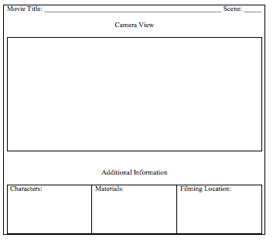
Phase 4: Storyboard
How does this phase connect to literacy?

Slide 8
Phase 6: Scripting
As students create their scripts they are analyzing the original text from the point of view of the writer. What did the author do to make his or her writing so engaging? How can we incorporate those features into my script?
Students practice their lines.
How does this phase connect to literacy?

Slide 9
Phase 7: Production
The student director runs the production of each scene, with input, of course, from other members of the production (and me). The director carries the storyboard and script, leads the class to filming locations, makes sure all props and materials are ready, and directs characters’ actions and assists with their lines.
How does this phase connect to literacy?

Slide 10
Phase 8: Post-Production
Students learn how to upload the movies into the software, drop clips into the editing line, delete unused takes, reorder and cut clips, configure special effects, utilize transitions, add music, and create title and credit sequences.
How does this phase connect to literacy?

Slide 11
Sophia Finds a Turtle
SPM Written and Produced by Second Graders
Genre: Comedy. Method: Parody
Video

Slide 12
SPMs and Literacy
Students reflected on their reading preference, identified different genres, composed summaries, drafted sequences, used their knowledge of story structure to deconstruct text and turn it into a new creation, rehearsed the script focusing on expressive and meaningful reading, proficiently wielded multiple technologies, and offered their unique understandings of text.
They had a purpose.

